Slide 1
Artificial Intelligence and Machine Learning
Functions, Class and Objects
Unit-2

Slide 2
Artificial Intelligence and Machine Learning
Content
Functions in C++ …………………… ………….…3
Why use Functions……………………………..…..5
Function Prototypes in C++ ……………….…........7
Function Defining………………............................10
Why Use Functions………………………………..12
Function Calling……………………………..…….13
Inline function in c++………………………..…….15
Default Arguments, Constant Arguments.................19
Function Overloading in C++…………………..….24
Defining Class………………………………...……27
Create an Object……………………………...……29
Access Modifiers in C++…………………….…….35
friend function in C++…………………….….……40

Slide 3

Functions in C++
Artificial Intelligence and Machine Learning
A Function is a reusable block of code designed to perform a specific task. It helps break large programs into smaller, logical parts. Functions make code cleaner, easier to understand, and more maintainable.
Just like in other languages, C++ functions can take inputs (called parameters), execute a block of statements, and optionally return a result. C++ also supports advanced features like function overloading, default arguments, and inline functions, which give more flexibility compared to C.
Functions, Class and Objects

Slide 4
Functions in C++
Artificial Intelligence and Machine Learning
In the above example, there are three functions:
main() function: This is the entry point of every C++ program. When the program runs, execution starts from the main function. It contains the calls to the other functions.
hello() function: This is a user-defined function that does not take any parameters and does not return a value. It simply prints "GeeksforGeeks" to the console. The return type void indicates that it doesn't return anything.
square(int x) function: This is another user-defined function that takes an integer as input and returns the square of that number. The return type int means the function will return an integer value. In main(), the function is called with the value 5, and the returned result is stored in a variable and printed.
Functions, Class and Objects

Slide 5
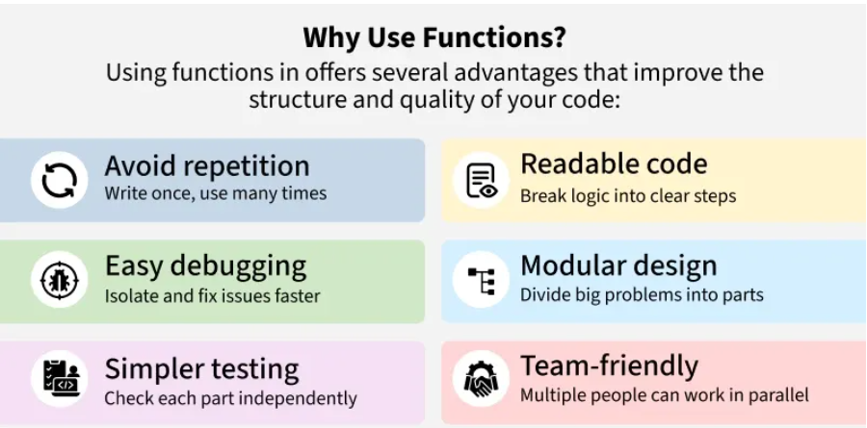
Why use Functions
Artificial Intelligence and Machine Learning
Functions, Class and Objects

Slide 6
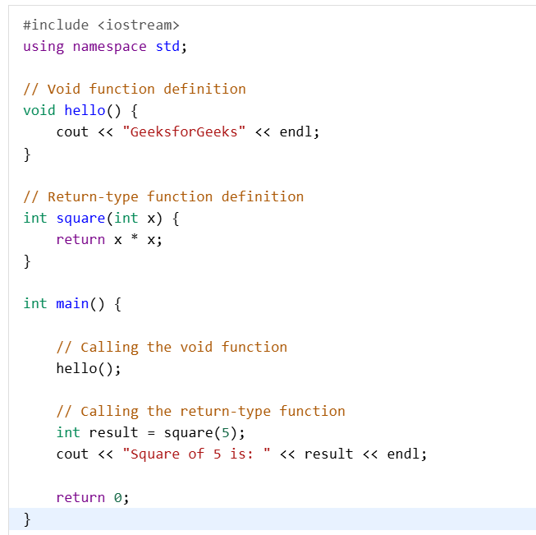
Functions in C++
Artificial Intelligence and Machine Learning
Functions, Class and Objects

Slide 7
Function Prototypes in C++
Artificial Intelligence and Machine Learning
In C++, function prototype is a function declaration that tells the compiler about the name of the function, its return type and the number and type of parameters. With this information, the compiler ensures that function calls can be linked to the function definition, even if the definition is not available at the time of call.
Functions, Class and Objects

Slide 8
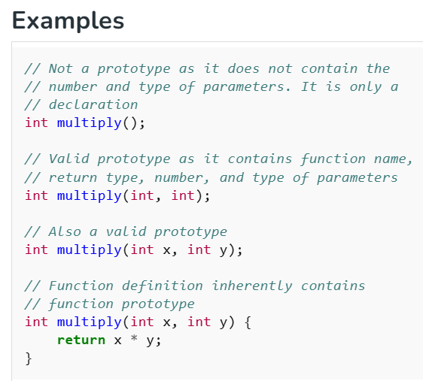
Function Prototypes in C++
Artificial Intelligence and Machine Learning
Syntax
The general syntax of the function prototype is as follows:
return_type name(type1, type2 ....);
Where,
return_type : Type of value the function returns.
name : Name of the function.
type1, type2 .... : Type of the parameters. Specifying their names is optional.
Functions, Class and Objects

Slide 9
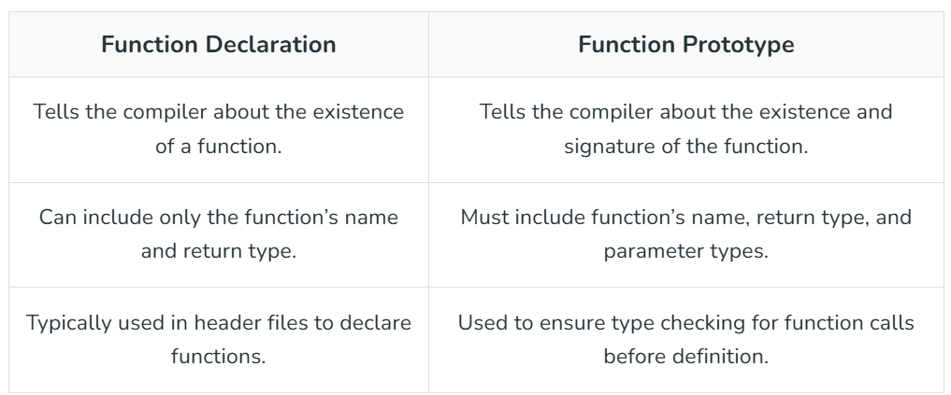
Function Declaration vs Function Prototype
Artificial Intelligence and Machine Learning
Functions, Class and Objects

Slide 10
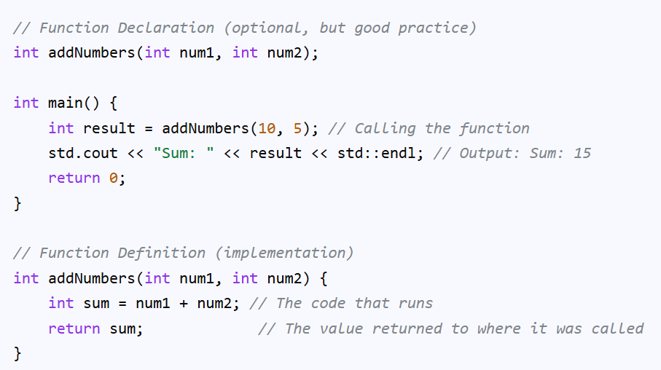
Function Defining
Artificial Intelligence and Machine Learning
In C++, defining a function involves specifying its return type, name, parameters (inputs), and the code block (body) that performs a specific task, making code reusable and organized.
The general syntax is returnType functionName(type1 param1, type2 param2) { // function body with statements; }, where void signifies no return value.
Functions, Class and Objects

Slide 11
Function Defining
Artificial Intelligence and Machine Learning
Key Components of a Function Definition:
Return Type: int, double, void (nothing), etc., indicating what data type the function sends back.
Function Name: The identifier used to call the function (e.g., addNumbers).
Parameters: Variables in parentheses that receive data (arguments) when the function is called (e.g., int num1, int num2).
Function Body: The statements inside curly braces {} that execute when the function runs.
Functions, Class and Objects

Slide 12
Why Use Functions?
Artificial Intelligence and Machine Learning
Reusability: Write code once, use it many times.
Modularity: Break down large programs into smaller, manageable parts.
Readability: Makes code easier to understand and debug.
Functions, Class and Objects

Slide 13
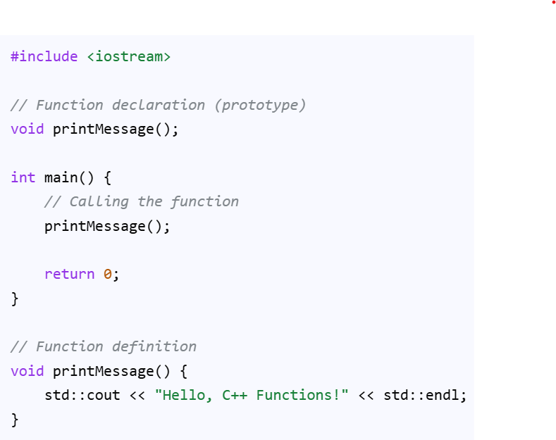
Function Calling
Artificial Intelligence and Machine Learning
A function call is a statement that transfers program control to the called function, executes its code, and then returns control to the point immediately after the call.
The basic syntax for calling a function is its name followed by parentheses () and a semicolon ;.
Functions, Class and Objects

Slide 14
C++ User-defined Function Types
Artificial Intelligence and Machine Learning
For better understanding of arguments and return values in functions, user-defined functions can be in various forms like:
Function with no argument and no return value
Function with no argument but return value
Function with argument but no return value
Function with argument and return value
Functions, Class and Objects

Slide 15
Inline function in c++
Artificial Intelligence and Machine Learning
An inline function in C++ is a function for which the compiler is requested to insert the function's code directly into the calling code at compile time, rather than performing a traditional function call. This eliminates the overhead of function calls (like managing the call stack) and can potentially lead to faster execution, especially for small, frequently called functions.
An inline function is a function in C++ whose code is expanded at the point of call at compile time. It reduces function-call overhead.
The inline keyword suggests replacing a function call with its code to reduce overhead.
Inlining is a request, not guaranteed by the compiler.
The compiler may ignore inlining if the function contains loops, recursion, static variables, switch/goto, or a non-void function without a return statement..
Functions, Class and Objects

Slide 16
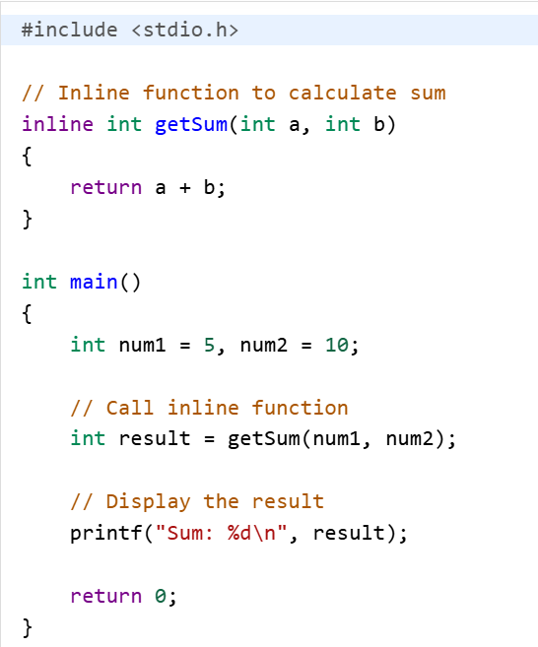
Inline function in c++
Artificial Intelligence and Machine Learning
Output: Sum: 15
Functions, Class and Objects

Slide 17
Need for Inline Functions
Artificial Intelligence and Machine Learning
Function calls involve overhead from storing the return address, passing arguments, and returning control, which can be significant for small, frequently used functions.
Inline functions help eliminate this overhead by replacing the function call with the actual code, improving efficiency.
Inline functions are useful only when the function call overhead is higher than the function’s execution time.
Functions, Class and Objects

Slide 18
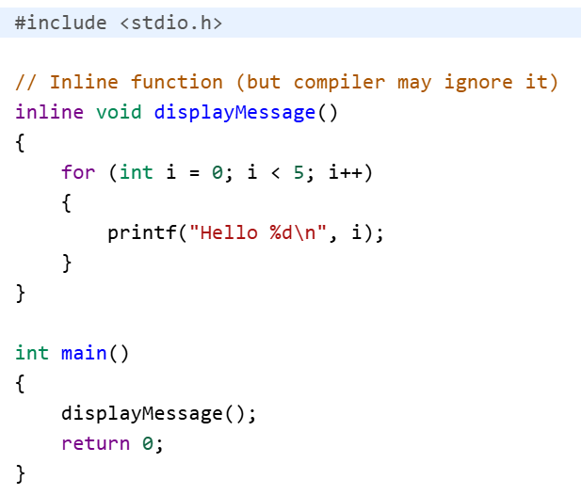
Inline Functions Example
Artificial Intelligence and Machine Learning
Output
Hello 0
Hello 1
Hello 2
Hello 3
Hello 4
Functions, Class and Objects

Slide 19
Default Arguments, Constant Arguments
Artificial Intelligence and Machine Learning
Default arguments provide optional values for function parameters, used if the caller doesn't supply them, while constant arguments (using const) ensure a function cannot modify the passed-in values, protecting data integrity, even though default values can be overwritten, const values are read-only within the function scope for safety and optimization. Essentially, defaults offer flexibility (can be changed), and const offers safety (cannot be changed).
Functions, Class and Objects

Slide 20
Default Arguments
Artificial Intelligence and Machine Learning
Purpose: A default argument is a value given to a function parameter.
If the user does not pass a value while calling the function, the default value is used automatically.
Syntax: return_type function_name(type parameter = default_value);
Behavior: The compiler uses the default value if no argument is provided; otherwise, the provided value overrides the default.
Rule: Default arguments must be given from right to left.
void fun(int a, int b = 10); ✔
void fun(int a, int b = 10, int c = 20); ✔
void fun(int a = 10, int b); ❌
void fun(int a, int b = 10, int c); ❌
Functions, Class and Objects

Slide 21
Default Arguments
Artificial Intelligence and Machine Learning
#include <iostream>
using namespace std;
void greet(string name = "Guest") { // Default in definition
cout << "Hello, " << name << endl;
}
int main() {
greet(); // Uses default
greet("John");
}
Functions, Class and Objects

Slide 22
Default Arguments
Artificial Intelligence and Machine Learning
#include <iostream>
using namespace std;
void show(int a = 10, int b = 20, int c = 30) {
cout << "a = " << a << ", b = " << b << ", c = " << c << endl;
}
int main() {
show(); // Uses all defaults
show(1); // a = 1, b & c default
show(1, 2); // a = 1, b = 2, c default
show(1, 2, 3); // All provided
}
Functions, Class and Objects

Slide 23
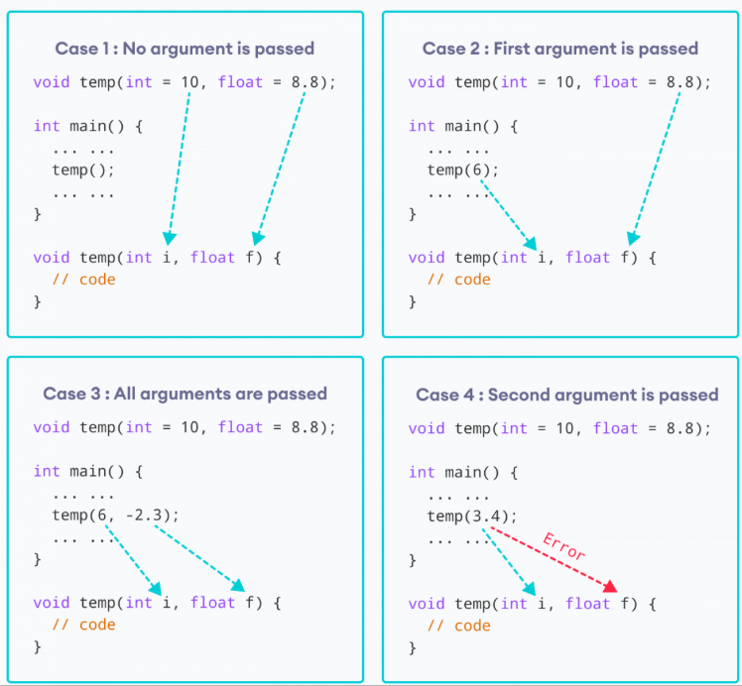
Working of default arguments
Artificial Intelligence and Machine Learning
Functions, Class and Objects

Slide 24
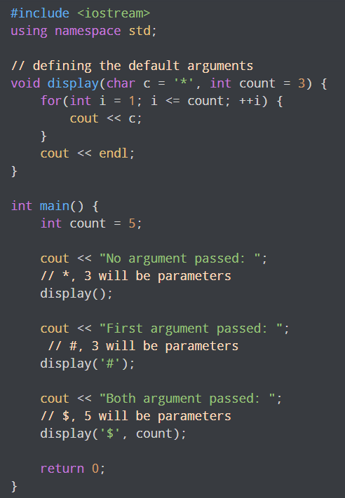
Default arguments
Artificial Intelligence and Machine Learning
Functions, Class and Objects

Slide 25
Constant Arguments
A constant argument is a parameter declared with const so that its value cannot be changed inside the function.
👉 It protects data from modification.
Syntax:
return_type function_name(const data_type variable);
#include <iostream>
using namespace std;
void show(const int x) {
// x = x + 5; // ❌ Not allowed (error)
cout << "Value: " << x;
}
int main() {
int a = 10;
show(a);
return 0;
}
Artificial Intelligence and Machine Learning
Functions, Class and Objects

Slide 26
Function Overloading in C++
Artificial Intelligence and Machine Learning
Function overloading allows us to define multiple functions with the same name but different parameters(type, number, or order).
It is a form of compile time polymorphism in which different functions with same name can perform different jobs based on the different parameters passed.
Avoids name conflicts and unnecessary function names (explained in the below example)
Makes the code easy to understand and making user friendly as the same meaningful function name is used for different types of inputs.
Functions, Class and Objects

Slide 27
Function Overloading in C++
Artificial Intelligence and Machine Learning
int main(){
Demo d;
cout << d.add(2, 3) << endl; // calls first function
cout << d.add(2, 3, 4) << endl; // calls second function
cout << d.add(2.5, 3.5) << endl; // calls third function
return 0;
}
#include <iostream>
using namespace std;
class Demo {
public:
// Function with 2 integers
int add(int a, int b) {
return a + b;
}
// Function with 3 integers
int add(int a, int b, int c) {
return a + b + c;
}
// Function with double values
double add(double a, double b) {
return a + b;
}
};
Functions, Class and Objects

Slide 28
friend function in C++
Artificial Intelligence and Machine Learning
A friend function in C++ is a function that is not a member of a class, but it can access the private and protected members of that class.
It is declared inside the class using the keyword friend.
Why Do We Need Friend Function?
Normally:
Private members ❌ cannot be accessed outside the class.
But sometimes:
We want an external function to access private data.
Especially useful in operator overloading or when working with two classes together.
That’s where a friend function is used.
Functions, Class and Objects

Slide 29
Friend Functions
Artificial Intelligence and Machine Learning
Syntax
class ClassName {
private:
int data;
public:
friend void functionName(ClassName obj);
};
The function is declared inside the class using friend
But it is defined outside the class
It is not called using object (obj.function() ❌)
Friend function call: functionname(objectname) ✔
Functions, Class and Objects

Slide 30
Artificial Intelligence and Machine Learning
class Demo {
private:
int x;
public:
void setValue(int a) {
x = a;
}
friend void show(Demo d);
};
void show(Demo d) {
cout << "Value of x: " << d.x;
}
int main() {
Demo obj;
obj.setValue(25);
show(obj);
return 0;
}
Functions, Class and Objects

Slide 31
Defining Class
Artificial Intelligence and Machine Learning
In C++, a class is a blueprint for creating objects, and an object is a specific instance of that class, which has memory allocated to it. The process involves defining the class structure and then instantiating objects from that definition.
A class is a user-defined data type, which holds its own data members and member functions that can be accessed and used by creating an instance of that class. A C++ class is like a blueprint for an object.
Create a Class : A class must be defined before its use. C++ class is defined using the keyword class keyword.
Functions, Class and Objects

Slide 32
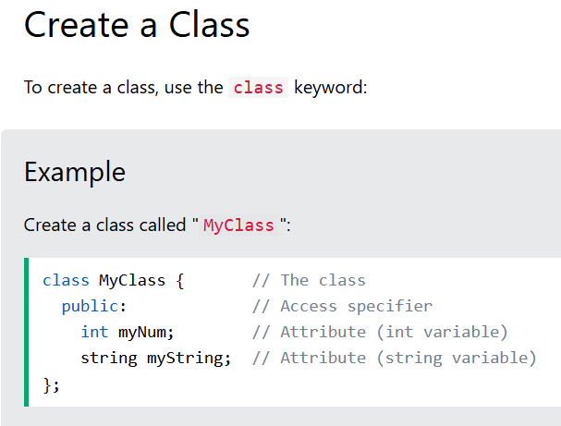
Create a Class
Artificial Intelligence and Machine Learning
C++ is an object-oriented programming language.
Everything in C++ is associated with classes and objects, along with its attributes and methods. For example: in real life, a car is an object. The car has attributes, such as weight and color, and methods, such as drive and brake.
Attributes and methods are basically variables and functions that belongs to the class. These are often referred to as "class members".
A class is a user-defined data type that we can use in our program, and it works as an object constructor, or a "blueprint" for creating objects.
Functions, Class and Objects

Slide 33
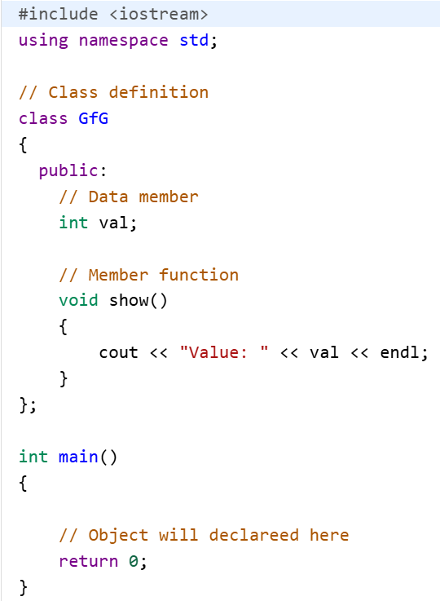
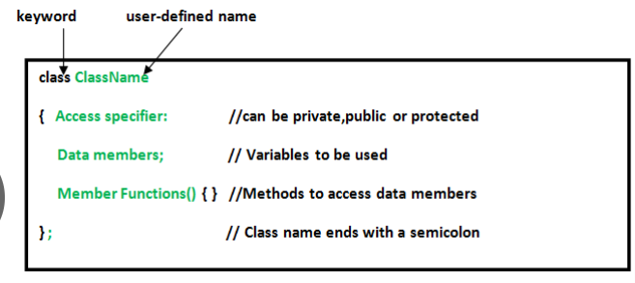
Class in C++
Artificial Intelligence and Machine Learning
Functions, Class and Objects

Slide 34
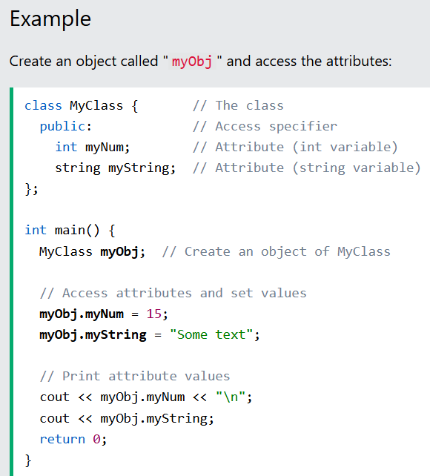
Create an Object
Artificial Intelligence and Machine Learning
In C++, an object is created from a class. We have already created the class named MyClass, so now we can use this to create objects.
To create an object of MyClass, specify the class name, followed by the object name.
To access the class attributes (myNum and myString), use the dot syntax (.) on the object:
Functions, Class and Objects

Slide 35
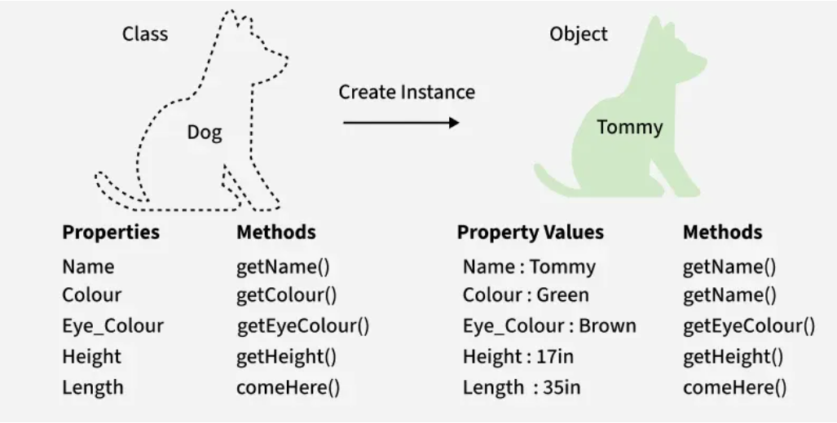
C++ Classes and Objects
Artificial Intelligence and Machine Learning
A class is a template to create objects having similar properties and behavior, or in other words, we can say that a class is a blueprint for objects.
An object is an instance of a class. For example, the animal type Dog is a class, while a particular dog named Tommy is an object of the Dog class.
Functions, Class and Objects

Slide 36
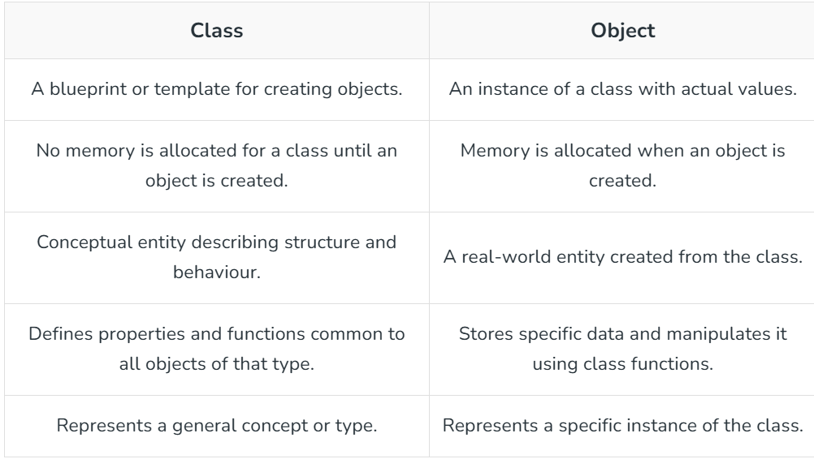
C++ Classes and Objects
Artificial Intelligence and Machine Learning
Functions, Class and Objects

Slide 37
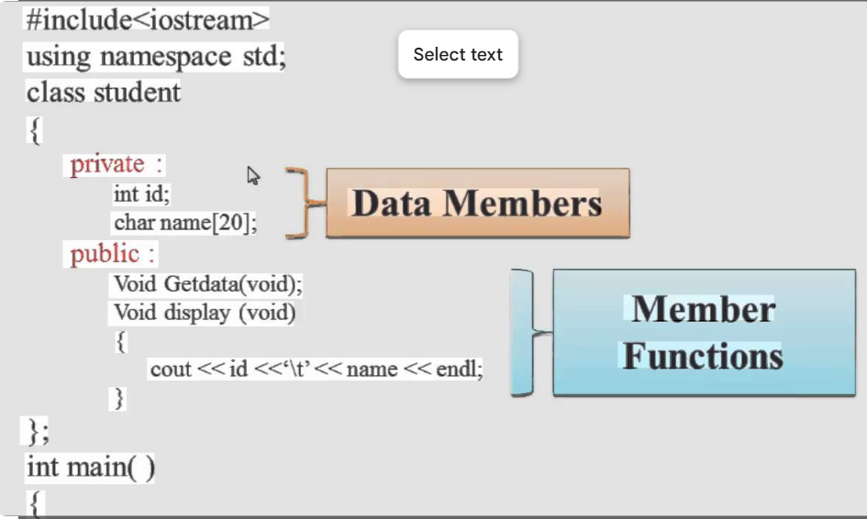
Defining Member function
Artificial Intelligence and Machine Learning
A member function is a function declared within a class that operates on the data members of that class. You can define a member function in one of two ways in C++: inside the class definition or outside the class definition using the scope resolution operator (::).
Functions, Class and Objects

Slide 38
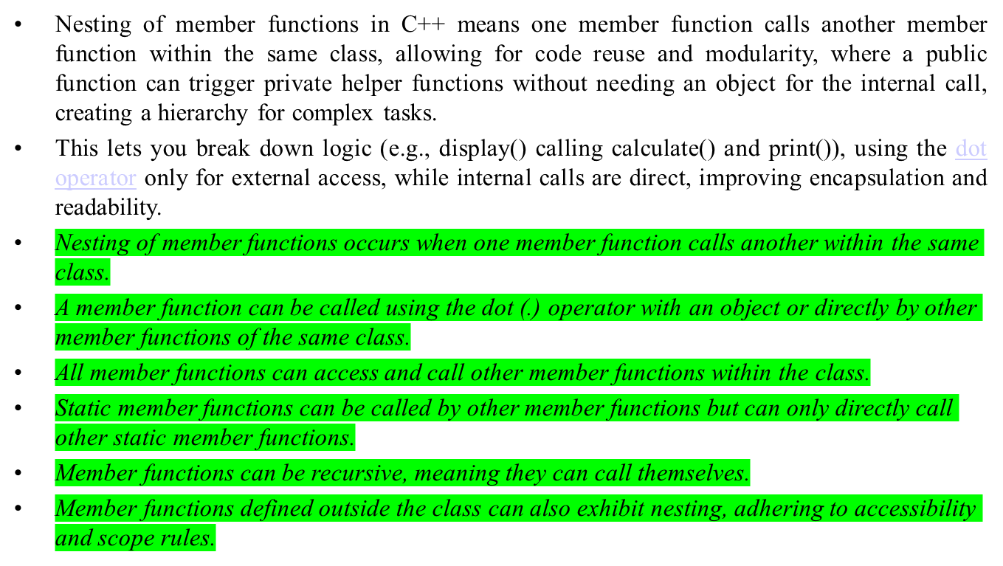
Nesting of member functions
Artificial Intelligence and Machine Learning

Slide 39
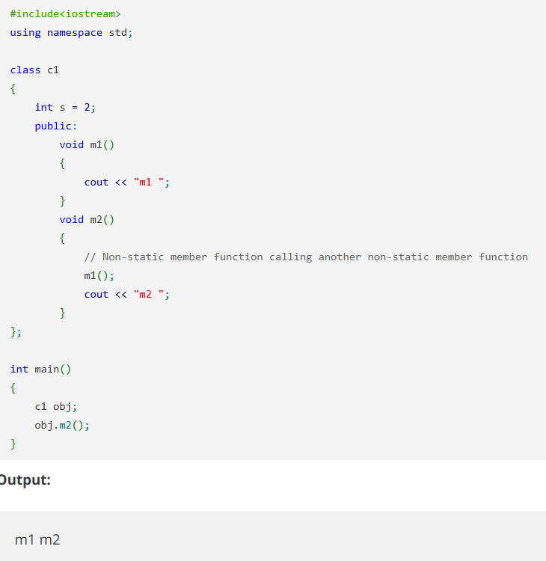
Nesting of member functions
Functions, Class and Objects

Slide 40
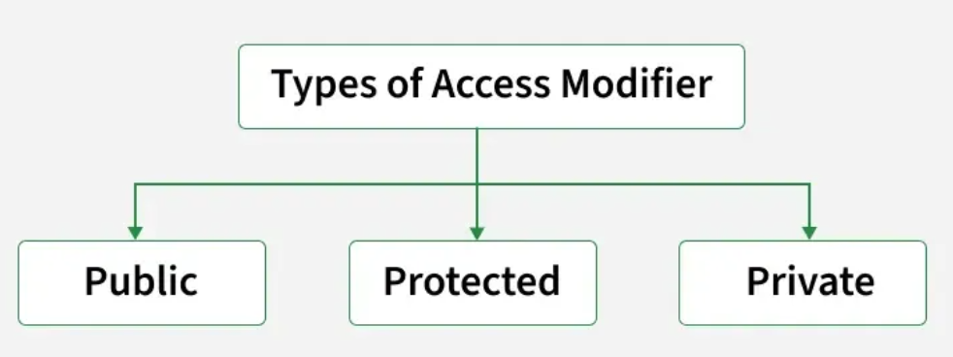
Access Modifiers in C++
Artificial Intelligence and Machine Learning
Access modifiers are special keywords in C++, that control the visibility of class members (data and functions).
They help in implementing data hiding by restricting or allowing access to certain parts of a class.
Functions, Class and Objects

Slide 41
Access Modifiers in C++
Artificial Intelligence and Machine Learning
1. Public Specifier
Public specifier makes class members (variables and functions) accessible from anywhere - inside the class, outside the class, or even other files.
2. Private Specifier
Private specifier makes class members accessible only inside the class itself (mainly member methods), and is mainly used to hide data from outside so that we can make changes internally later without changing the code of its users. By default, all class members in C++ are private if no specifier is mentioned.
Functions, Class and Objects

Slide 42
Private member functions
Artificial Intelligence and Machine Learning
Private member functions are methods within a class that are hidden from the outside world, accessible only by other members (functions or friends) of the same class, enforcing encapsulation by controlling access to internal logic, often used as helpers for public functions to perform tasks like data validation or complex calculations, preventing direct external interference.
Functions, Class and Objects

Slide 43
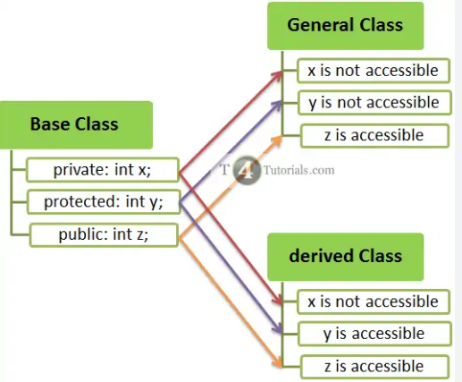
Private member access
Artificial Intelligence and Machine Learning
In C++, private members (variables/functions) are hidden and inaccessible from outside the class, enforcing encapsulation; they can only be accessed by the class's own member functions or declared friend functions/classes, typically through public methods (getters/setters) to control access, though pointer tricks exist but are risky
Functions, Class and Objects

Slide 44
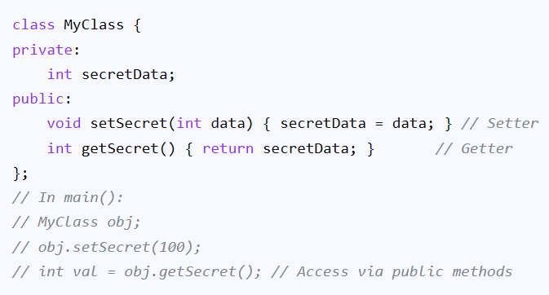
Public Member Functions (Getters/Setters):
Artificial Intelligence and Machine Learning
Functions, Class and Objects

